Slide 1
Annual Day of My College

Slide 2
Perform
Musical Dance
Song
Drama

Slide 3
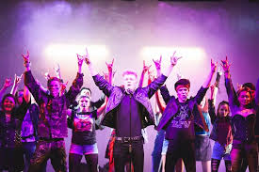
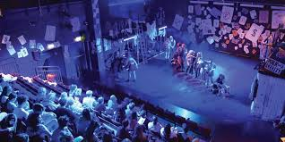
Some Picture

Slide 4
That sounds like a lot of fun! Annual day celebrations at college are often full of excitement and memorable moments. Do you have any specific memories or highlights from your college’s annual day that stand out? Maybe a performance, a special guest, or a fun moment with friends?

